Slide 1
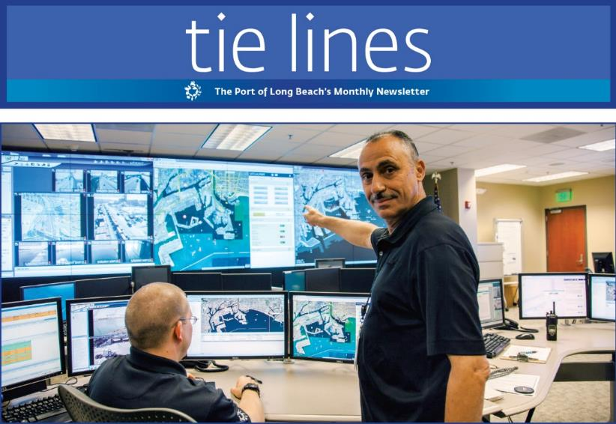
Port of Long Beach
Tie Lines Industry Subscription Newsletter
Periodicals

